Slide 1

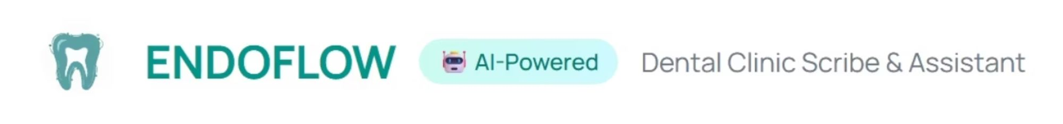
EndoFlow: A No-Code Blueprint for an AI-Powered Endodontic Clinical Agent Using Open-Source Workflow Automation
IES Registration no.: IES0893
Notes:
Good morning, esteemed colleagues and members of the Indian Endodontic Society. My name is Dr.Nisarg.and today I am privileged to present "EndoFlow" – a no-code blueprint for an AI-powered endodontic clinical agent, using open source workflow automation.

Slide 2
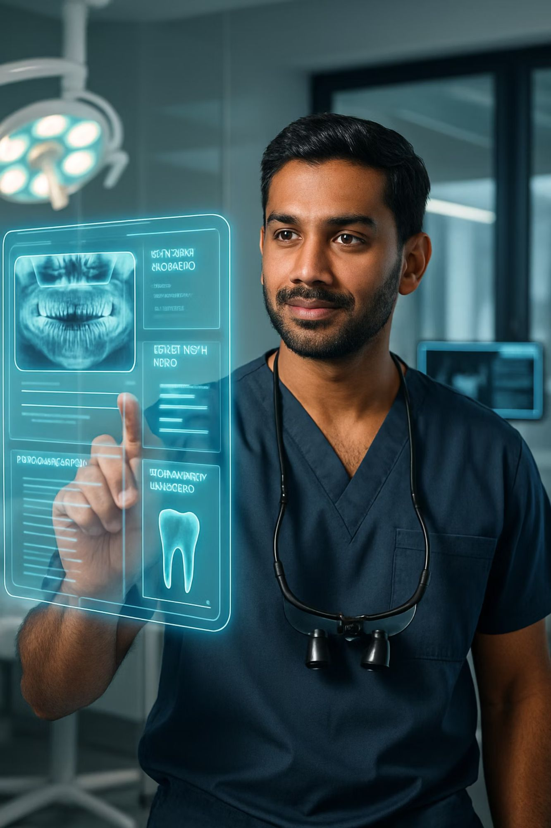
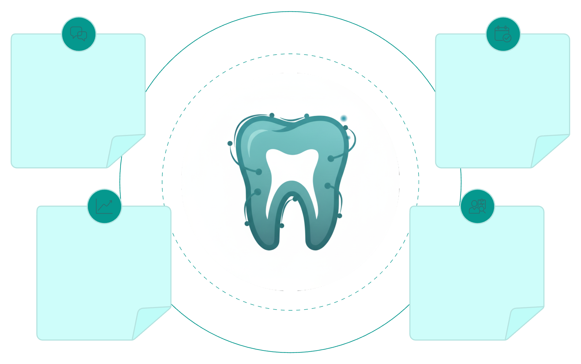




Imagine a world where your endodontic practice is seamlessly powered by intelligence.
Talk to your clinic AI
Schedule and Manage
Engage with an intelligent assistant for your clinical needs.
Easily handle appointments and administrative tasks efficiently.
Analyze and Learn
Diagnose and Tx planning
Gain insights from evidence-based data analysis.
Support for diagnosis and creating effective treatment plans.
But what's holding us back from this level of transformative excellence?
Notes:
EndoFlow is what many of us have wished for: a true AI-powered scribe and assistant. Imagine your practice seamlessly powered by intelligence. A world where you can talk to your clinic's AI to instantly analyze patient data, get diagnostic support, and manage your schedule by voice. But what's holding us back?

Slide 3

















An Abundance of Tasks & Scarcity of Time
Diagnostician
Therapist
Administrator
Communicator
Data-Rich, Insight-Poor
2-D radiograph, C.B.C.T. Clinical photos
Patient's consultation and financial record
Regular update clinic ledger, Assistant's management
Your knowledge Article references
Notes:
This image is familiar. The reality of our profession is an abundance of tasks and a scarcity of time. We are trained as diagnosticians and therapists, but we spend huge portions of our day as administrators, manually managing information. The irony is our practices are data-rich—generating vast amounts of CBCTs, radiographs, and notes—but we remain insight-poor. Our data is siloed across different computers, requiring significant effort to collate, by which time the opportunity for insight is lost.

Slide 4
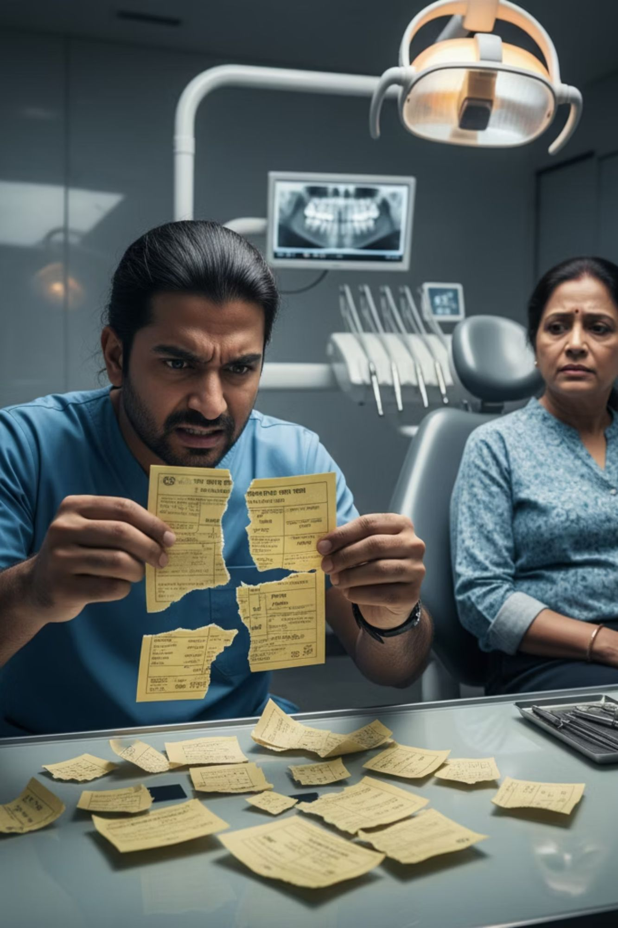



Pyramid of reason for evolution of Dental Records
For years, patient records primarily existed on paper, often as OPD cards entrusted to the patient. This system, while traditional, presented significant challenges for continuity of care and practice management.
Lack of Centralization
1
Data was scattered, making it difficult to access comprehensive patient histories or conduct broader practice analysis.
Manual Data Capture
2
Dentists often resorted to photographing paper cards, creating fragmented and inefficient digital archives.
Lost or Damaged Cards
3
Patients frequently arrived with lost, torn, or incomplete records, leading to gaps in essential medical history.
The clear need for a more robust, centralized system led to the advent of digital Practice Management Software (PMS) to streamline clinic operations.
Notes:
For decades, we relied on paper OPD cards. We've all faced the frustration of a patient arriving with a lost or torn card, instantly erasing a complex history and wasting all our previous efforts. The clear need for centralization led us to digital Practice Management Software, or PMS.

Slide 5
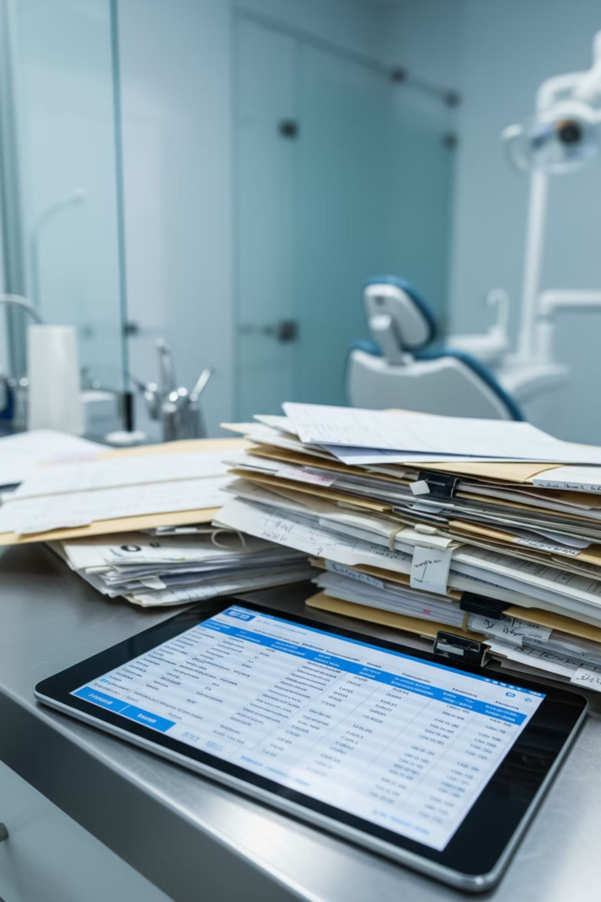
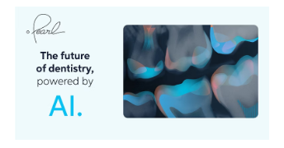










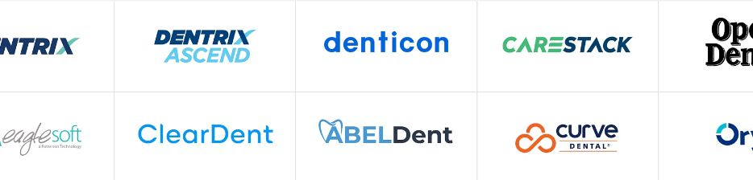
Addressing the Challenges: The Rise of Dental Software Solutions
To navigate the complex landscape of modern endodontic practice and reduce friction, a variety of software solutions have emerged. These tools aim to streamline operations, manage data, and enhance clinical decision-making. We'll explore two main categories that have become integral to dental offices today.
Existing Dental Software Solutions
AI-Powered Dental Solutions
Notes:
These PMS solutions were a major step forward. They digitized our paper problems, giving us a central, reliable place to store records. For the first time, we could instantly recall a patient's history, radiographs, and treatment notes without searching through a physical file cabinet. And now, we are in the next wave of evolution: the rise of powerful, niche AI tools. We see incredible software that can analyze a 2D radiograph and highlight potential caries, or segment a CBCT scan. These tools are highly specialized for specific tasks like imaging analysis and diagnostics.

Slide 6

Why Current Software Falls Short
While these solutions represent progress, they still have significant limitations that prevent true endodontic excellence.
1
2
Fragmented AI
Siloed Workflows
Powerful AI tools exist, but they work alone. They don't connect to your main work and can't talk to each other.
There are big gaps between patient care and office tasks. This causes problems and can lead to mistakes or delays.
3
4
Static "Evidence"
No Internal Research
These systems use old rules that don't change. They can't learn from new research or adapt to better ways of doing things.
The software can't look at your own practice's past results. This means you can't improve your methods over time.
Notes:
But this creates a new problem. This clinician, drowning in data across multiple screens, is still us. Why? Because today's solutions have four critical failings: 1-We have powerful but isolated tools, forcing us to switch between multiple applications for a single patient. 2-This fragmentation adds to our administrative burden, making simple data storage another time-consuming task. 3- Their protocols are static, taking years to incorporate new breakthrough research. 4-The software cannot analyze our own practice data, preventing us from learning from our own work.

Slide 7
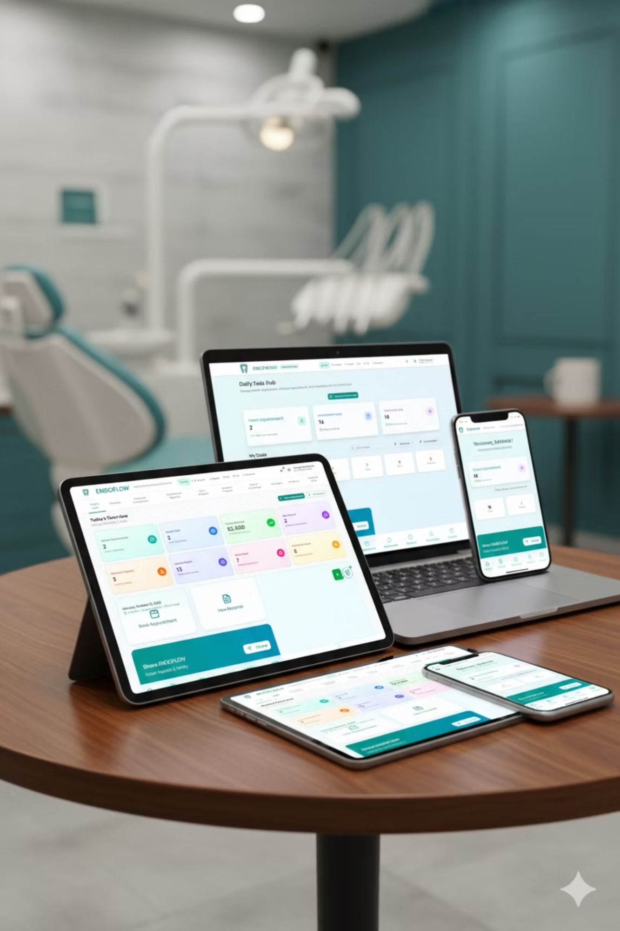
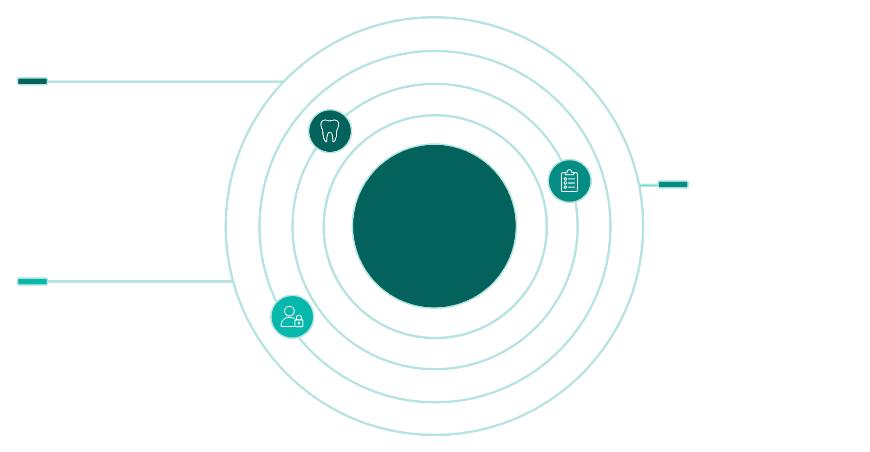



Introducing EndoFlow
EndoFlow is the AI-powered central nervous system for dental practices. Today, I'll show you how it represents more than just another software – it's a paradigm shift in endodontics. We're moving beyond simple practice management to cultivate a truly intelligent, learning, and adaptive clinical environment, meticulously designed to resolve critical systemic inefficiencies that currently hinder clinical excellence and operational viability.
Dentist Dashboard
AI powered voice controlled 24/7 co-pilot, assistant and scribe.
EndoFlow
AI Core
Assistant Dashboard
Patient management, Xray upload, appointment scheduling and Task board
Patient Dashboard
Records, communication, and Personilized care
Notes:
To solve this, my colleague from IIT and I developed EndoFlow. It is not just another app. It is designed to be the AI-powered central nervous system for your entire practice, accessible on every device. The EndoFlow Ecosystem - It's a unified ecosystem with three dedicated dashboards: one for the dentist, one for the assistant, and a portal for the patient to access their own records and treatment information.

Slide 8
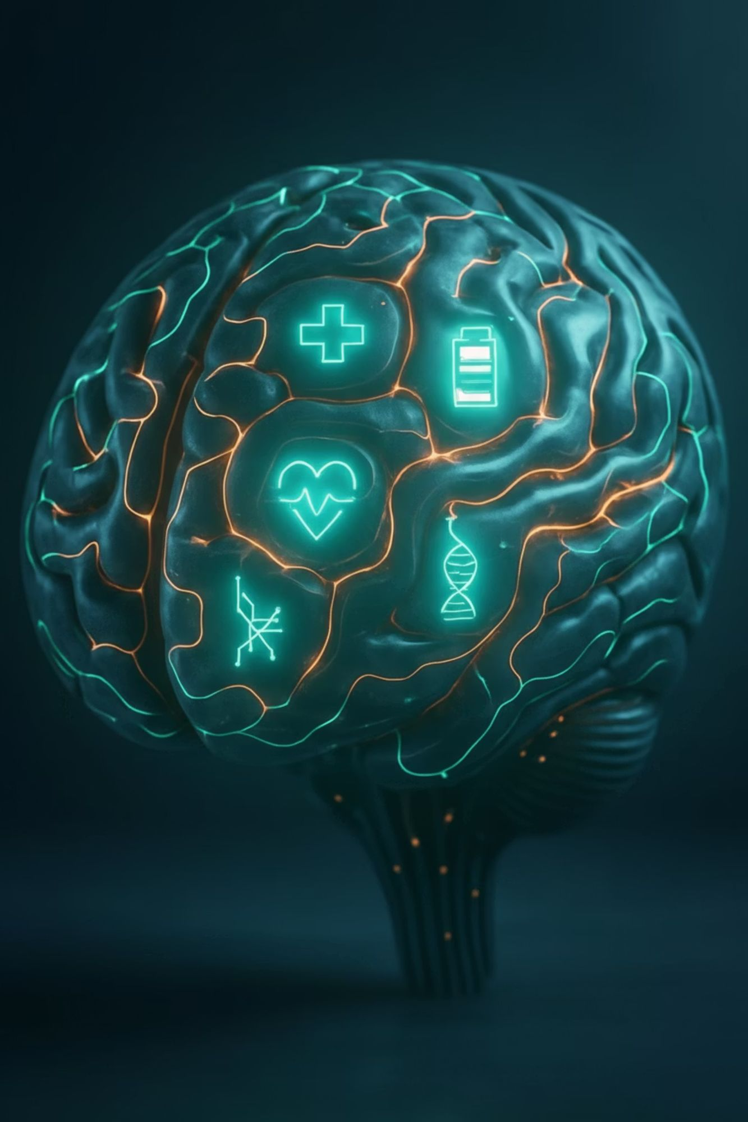





EndoFlow's AI core: Five-Pillar AI Engine
"Hey EndoFlow”
Conversational AI
Endo-AI Co-Pilot
Evidence-based clinical partner
Hands-free scribe assistant
2
1
Research & Analytics AI
3
5
Internal research department
4
AI Scheduler
Proactive optimisation
Self-Learning AI
Personalised clinical memory
Notes:
Today, we'll focus on the Dentist Dashboard, which is built on a Five-Pillar AI Engine. These pillars are: An Endo-AI Co-Pilot: A evidence-based clinical partner. Conversational AI: Just say "Hey EndoFlow," and you can have a complex, back-and-forth conversation with your practice. A Research & Analytics AI that, as we'll see, generates insights from your own data. A Self-Learning AI: This is crucial. It reads and ingests new research papers with you, allowing you to ask questions directly about the paper's methodology and conclusions, etc. And an AI Scheduler that doesn't just book patients—it manages your assistant's tasks in real-time, so you know exactly what is being done.

Slide 9
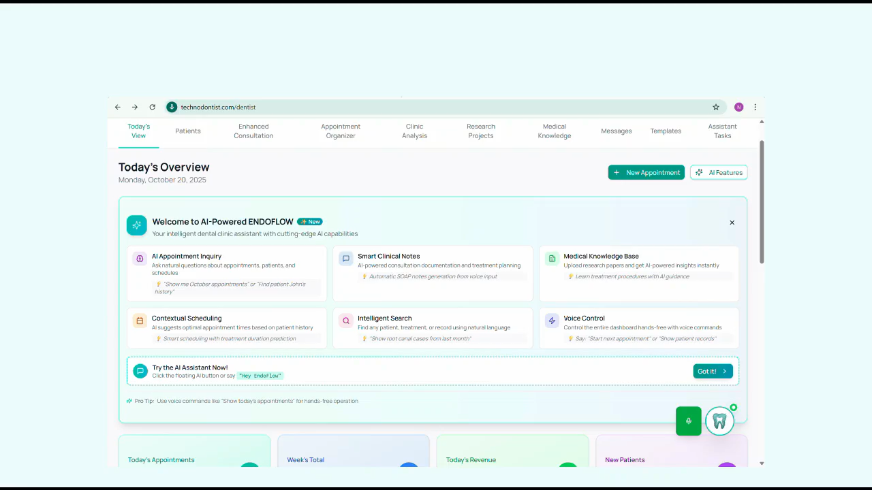

Slide 10






AI-Powered Clinical Intelligence
EndoFlow is built upon a sophisticated AI engine, integrating five core components designed to enhance every aspect of your endodontic practice.
Clinic Analytics AI
Self-Learning Assistant
Voice-Controlled Interface
Our AI continuously analyzes vast datasets, bringing the latest clinical evidence and insights directly to your workflow.
EndoFlow learns from your practice's unique patterns and outcomes, providing personalized support that evolves with you.
Interact seamlessly with EndoFlow using natural language, allowing for hands-free documentation and immediate information retrieval.
Predictive Scheduling
Intelligent Task Management
Research Project AI
Optimize your patient flow and appointment book with AI-driven predictions, minimizing no-shows and maximizing efficiency.
Helps you create research projects and provides live AI analytics. Talk to your thesis, create projects by dictating or writing inclusion criteria, and AI will find all patients that fit the criteria.
Streamline administrative and clinical tasks, ensuring no detail is overlooked and practice operations run smoothly.
Notes:
What you just witnessed in the live demonstration is how these five pillars translate from concepts into a powerful, functioning clinical partner.
When you saw us use a simple voice or text command like, "Hey EndoFlow, what is the irrigation protocol for cases with pulp necrrobiosis?"—that is our Self-Learning AI and RAG engine in action. It's solving the "Static Evidence" problem by giving you instant access to the latest research, not outdated rules.
When you saw us ask, "Show me all root canal cases from last month,"—that is our Clinic Analytics AI leveraging clinical data mining. We are, for the first time, solving the "Data-Rich, Insight-Poor" problem.
And the entire interaction, happening hands-free? That is our Conversational AI and NLP engine eliminating the "administrator" burden.
This is how EndoFlow uses an integrated suite of modern AI technologies to transform your clinic data from a dead archive into a live, intelligent, queryable database that actively works for you.

Slide 11
EndoFlow's Holistic AI Approach vs. Niche Competitors
AI Features | EndoFlow | Pearl AI | Overjet | VideaHealth | Chairsyde AI | CareStack AI | Dental Intelligence | Oryx AI | SmileCloud AI | Curve AI
Natural Language Processing (NLP) | ✓✓✓ | ✓ | ✓ | ✗ | ✓✓ | ✓✓ | ✗ | ✓ | ✗ | ✗
Computer Vision & Image Analysis | ✓✓✓ | ✓✓✓ | ✓✓✓ | ✓✓✓ | ✓ | ✓ | ✗ | ✓✓ | ✓✓ | ✓
Predictive Analytics | ✓✓✓ | ✓✓ | ✓✓ | ✓ | ✗ | ✓✓ | ✓✓✓ | ✓✓ | ✗ | ✓
Machine Learning Algorithms | ✓✓✓ | ✓✓✓ | ✓✓✓ | ✓✓✓ | ✓ | ✓✓ | ✓✓ | ✓✓ | ✓ | ✓✓
Real-time Decision Support | ✓✓✓ | ✓✓✓ | ✓✓✓ | ✓✓ | ✓✓ | ✓✓ | ✗ | ✓✓ | ✗ | ✓
Evidence-based Recommendations | ✓✓✓ | ✓✓✓ | ✓✓ | ✓✓ | ✓ | ✓ | ✗ | ✓✓ | ✗ | ✗
Voice Recognition & Transcription | ✓✓✓ | ✗ | ✗ | ✗ | ✓✓✓ | ✓ | ✗ | ✗ | ✗ | ✗
Automated Documentation | ✓✓✓ | ✗ | ✗ | ✗ | ✓✓✓ | ✓✓ | ✗ | ✓ | ✗ | ✓
Pattern Recognition | ✓✓✓ | ✓✓✓ | ✓✓✓ | ✓✓✓ | ✓ | ✓✓ | ✓ | ✓✓ | ✓ | ✓
Clinical Data Mining | ✓✓✓ | ✓✓ | ✓✓ | ✓✓ | ✗ | ✓✓ | ✓✓✓ | ✓✓ | ✗ | ✓
Workflow Automation | ✓✓✓ | ✗ | ✗ | ✗ | ✓ | ✓✓✓ | ✓✓✓ | ✓✓ | ✗ | ✓✓
Continuous Learning | ✓✓✓ | ✓✓✓ | ✓✓✓ | ✓✓ | ✓ | ✓✓ | ✓ | ✓✓ | ✗ | ✓
Multi-modal AI Integration | ✓✓✓ | ✓✓ | ✓ | ✓ | ✗ | ✓ | ✗ | ✓ | ✗ | ✗
Research Database Integration (RAG) | ✓✓✓ | ✗ | ✗ | ✗ | ✗ | ✗ | ✗ | ✗ | ✗ | ✗
Personalized Treatment Suggestions | ✓✓✓ | ✓✓ | ✓ | ✓ | ✓ | ✓ | ✗ | ✓ | ✓✓ | ✗
Notes:
When we compare EndoFlow to existing solutions, the difference is clear. the difference becomes clear. Existing solutions are niche tools—they might be very good at one specific task, like analyzing a radiograph. But EndoFlow is designed as a comprehensive umbrella.

Slide 12
EndoFlow vs Current AI Dental Solutions: A Comprehensive Analysis
Understanding how EndoFlow stands apart from existing AI tools is crucial for grasping its transformative potential in endodontic practice.
Approach
Integrated, end-to-end workflow automation and decision support across the entire clinical and administrative process
Fragmented, point solutions for specific tasks (e.g., diagnosis, imaging analysis)
AI Technology
RAG (Retrieval Augmented Generation) powered AI, dynamic, continuous learning from all practice data and internal research
Static algorithms, rule-based systems; limited learning from practice-specific data
Data Utilization
Aggregates and analyzes all structured and unstructured practice data (clinical, financial, research) for actionable insights
Limited to specific data types (e.g., radiographic images), siloed data processing
Workflow Automation
No-code, comprehensive workflow automation, minimizing manual input and optimizing efficiency
Manual or partial automation of isolated tasks
Adaptability
Flexible, adapts to new evidence and learns from individual practice outcomes to refine recommendations
Rigid, slow to adapt to new research or evolving clinical standards
Notes:
It's a holistic system that connects all the disparate pieces—the imaging, the scheduling, the clinical notes, and the research—into one single, intelligent system, eliminating the fragmentation that costs us so much time. It automates the entire workflow, not just one piece of it.

Slide 13
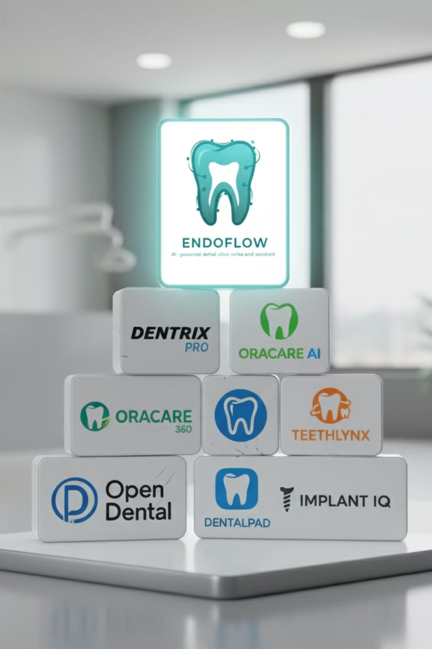




EndoFlow: Charting the Course to Endodontic Excellence
Truly Integrated AI Suite
Five-pillar AI engine woven into the three-dashboard ecosystem creates synergistic effects that fragmented solutions cannot replicate.
RAG Evidence Engine for learning and diagnose
Retrieval Augmented Generation for fact-based teaching and diagnosingP.
Practice as a Learning system
Unique ability to turn practice data into queryable research database. Empowers internal audits, outcome comparisons, and practice-specific evidence generation for continuous improvement.
Notes:
This brings us to how EndoFlow helps us achieve true endodontic excellence. It rests on three pillars:
A Truly Integrated AI Suite. A RAG Evidence Engine that keeps you current. And, in my opinion, the most transformative pillar: Practice as a Learning System. What does this mean? It means EndoFlow turns your qualitative feelings into quantitative facts. You can finally get answers to critical questions: "Which of my procedures is performing better?" "What is the 5-year success rate for my single-visit vs. multi-visit treatments?" You can learn directly from your own hands.

Slide 14

The New Economy of Dentistry
Time & Data: The New Oil
Time
The finite resource that dictates your capacity for care, your work-life balance, and your ability to maintain clinical excellence without burnout.
Data
The raw material for clinical wisdom and operational intelligence—valuable only when it can be accessed, analysed, and acted upon.
These two assets will define the success of future dental practices. With EndoFlow, you can command both—reclaiming precious hours whilst unlocking the strategic insights hidden within your practice data.
Notes:
With this, EndoFlow allows us to command the new oil of the 21st century: Time and Data. We reclaim our time, and we unlock the immense value hidden in our own practice data.

Slide 15

The Triple Impact: Transforming Practice, Research & Life
Superior Patient Care
Accelerated Research Discovery
EndoFlow removes administrative burden, allowing more time for diagnosis, explanation, and building trust. This leads to enhanced clinical decision-making and improved patient communication.
AI-powered analysis of 10,000+ medical papers enables faster identification of breakthrough endodontic techniques and evidence-based protocols, keeping you current with the latest research automatically.
Enhanced Work-Life Balance
With 24/7 AI assistance, EndoFlow reduces after-hours work and prevents burnout, fostering sustainable practice growth and freeing up valuable personal time.
Notes:
Ultimately, this delivers the triple impact we all strive for: Superior Patient Care, because we have more time and better insights. Accelerated Research, because we can generate and apply new evidence almost instantly. And finally, a healthier, more sustainable Work-Life Balance for every single one of us. Thank you.

